Slide 1
AWS COURSE
By Purusothaman S

Slide 2
What’s AWS?
AWS (Amazon Web Services) is a Cloud Provider
• They provide you with servers and services that you can use on demand and scale easily
• AWS has revolutionized IT over time
• AWS powers some of the biggest websites in the world
• Amazon.com
• Netflix

Slide 3
AWS Cloud History

Slide 4
Internally launched
Launched publicly with SQS
Launched in Europe
2002
2003
2004
2006
2007
Amazon infrastructure is one of their core strength. Idea to market
Re -launched publicly with SQS, S3 & EC2

Slide 5
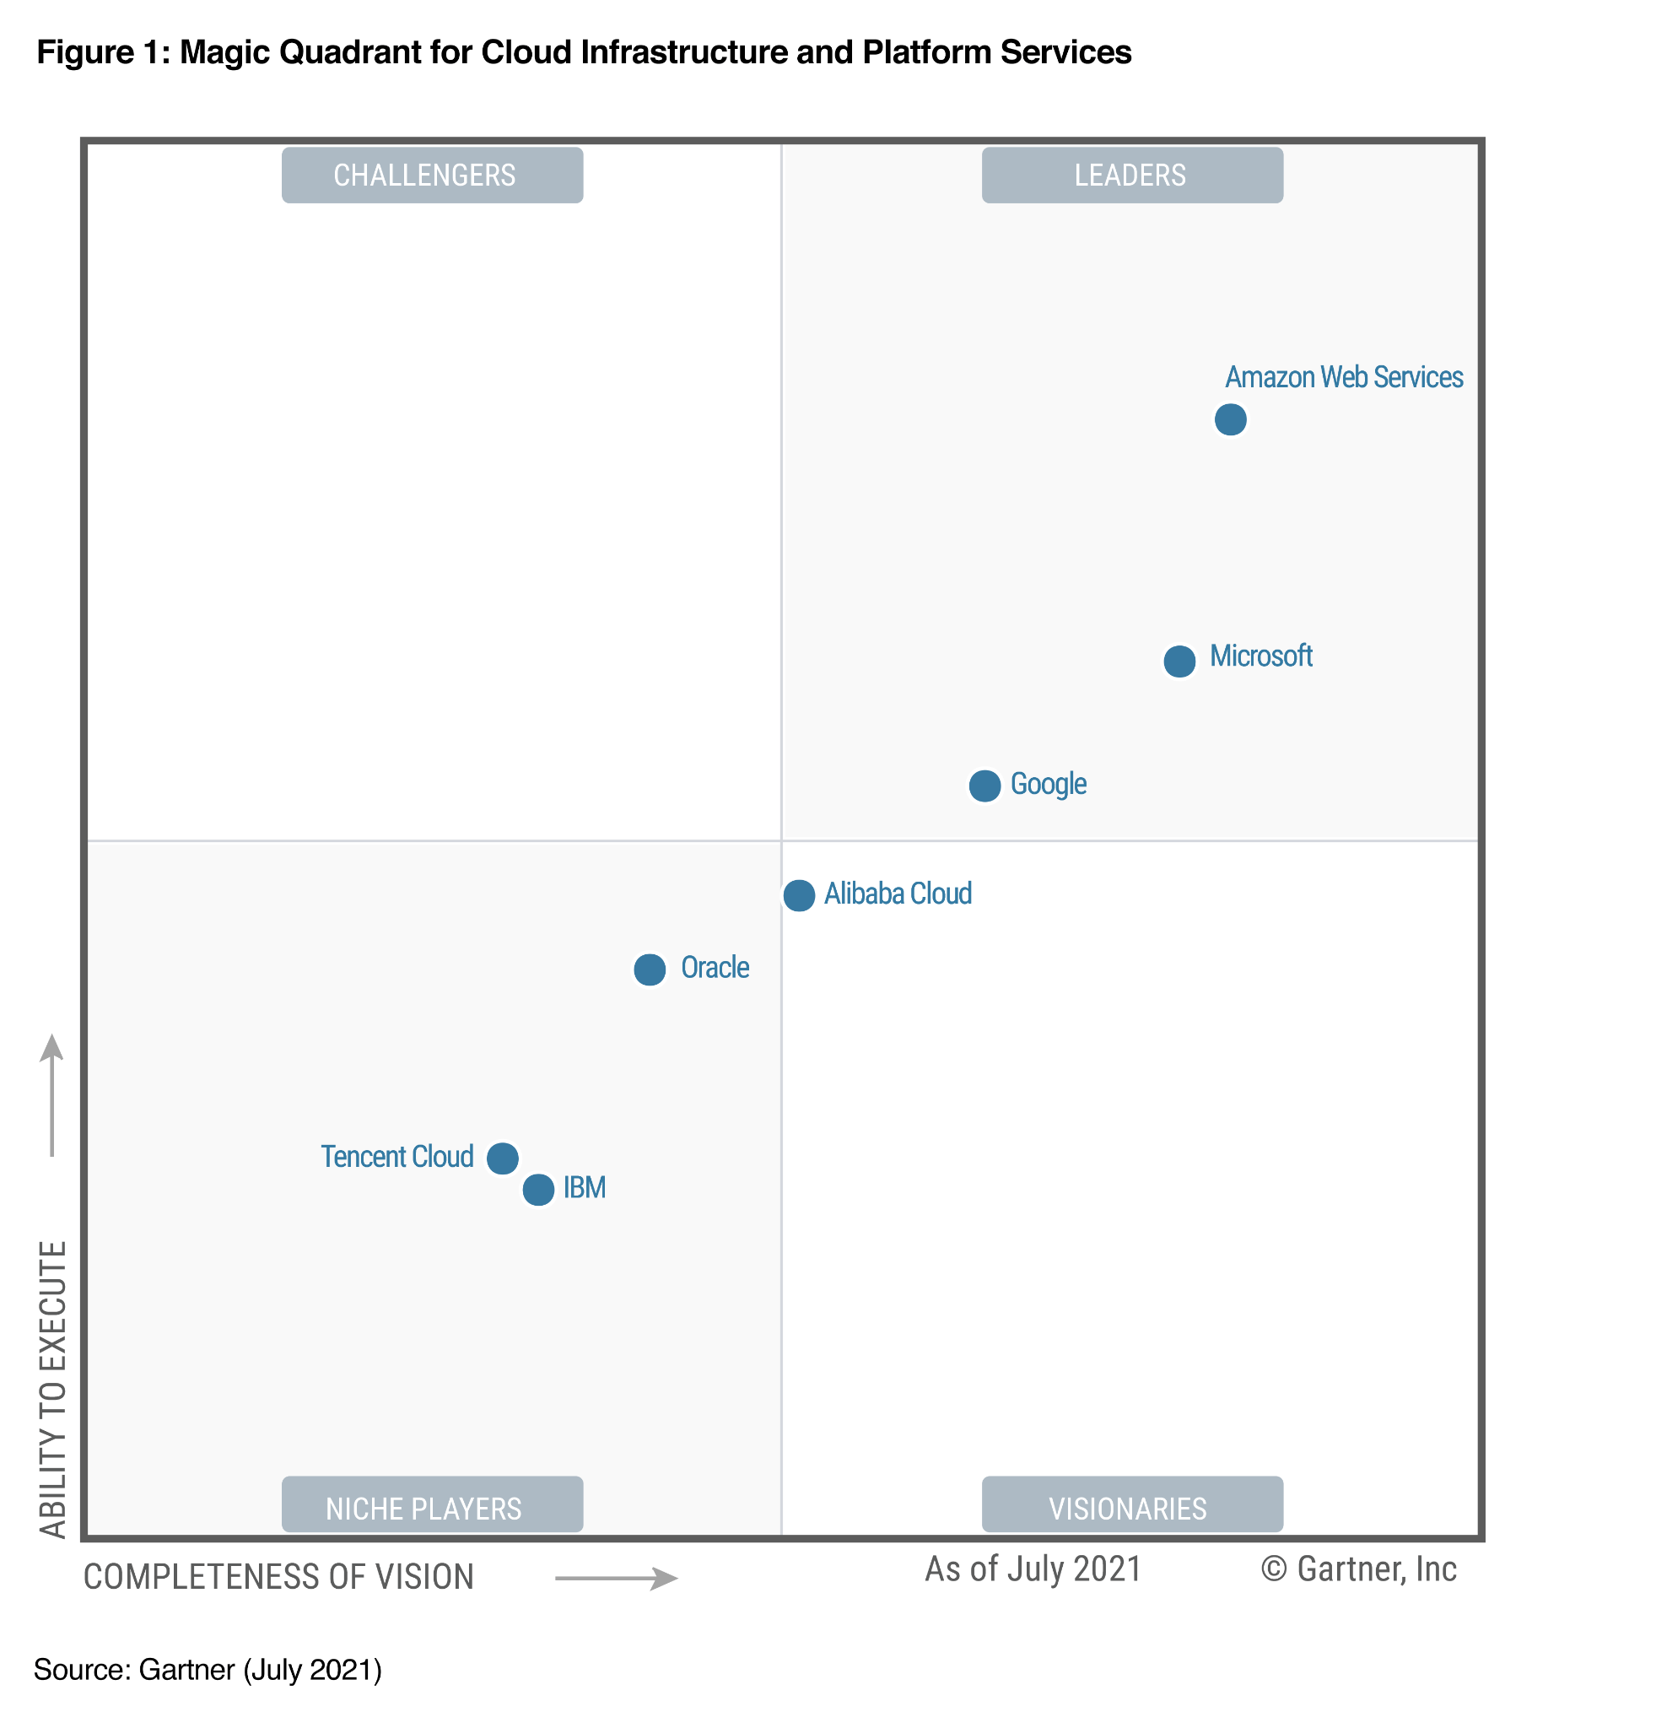
AWS Cloud Number Facts
• In 2021, AWS had $110.8 billion in annual revenue
• AWS accounts for 32% of the market in 2021(Microsoft is 2nd with 19%)
• Over 1,000,000 active users

Slide 6




AWS Cloud Use Cases
• AWS enables you to build sophisticated, scalable applications
• Applicable to a diverse set of industries
• Use cases include • Enterprise IT, Backup & Storage, Big Data analytics
• Website hosting, Mobile & Social Apps
• Gaming

Slide 7
AWS Global Infrastructure
• AWS Regions
• AWS Availability Zones
• https://infrastructure.aws/

Slide 8
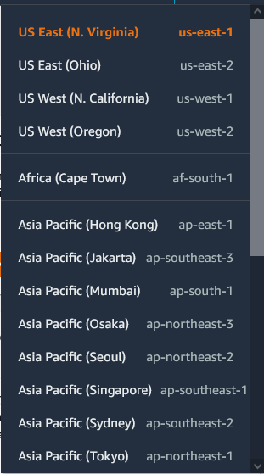
AWS Regions
• AWS has Regions all around the world
• Names can be us-east-1, eu-west-3…
• A region is a cluster of data centers
• Most AWS services are region-scoped

Slide 9
How to choose an AWS Region?
If you need to launch a new application, where should you do it?
• Compliance with data governance and legal requirements: data never leaves a region without your explicit permission
• Proximity to customers: reduced latency
• Available services within a Region: new services and new features aren’t available in every Region
• Pricing: pricing varies region to region and is transparent in the service pricing page

Slide 10
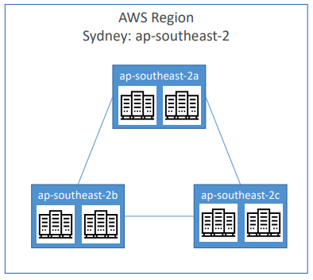
AWS Availability Zones
• They’re separate from each other, so that they’re isolated from disasters
• They’re connected with high bandwidth, ultra-low latency networking
• Each region has many availability zones (usually 3, min is 2, max is 6). Example:
• ap-southeast-2a
• ap-southeast-2b
• ap-southeast-2c
• Each availability zone (AZ) is one or more discrete data centers with redundant power, networking, and connectivity

Slide 11
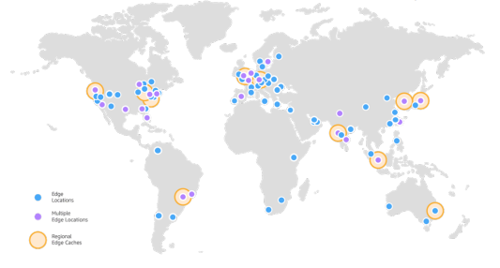
AWS Points of Presence (Edge Locations)
• Amazon has 216 Points of Presence (205 Edge Locations & 11 Regional Caches) in 84 cities across 42 countries
• Content is delivered to end users with lower latency
https://aws.amazon.com/cloudfront/features/

Slide 12
Tour of the AWS Console
• AWS has Global Services:
• Identity and Access Management (IAM)
• Route 53 (DNS service)
• CloudFront (Content Delivery Network) • WAF (Web Application Firewall)
• Most AWS services are Region-scoped:
• Amazon EC2 (Infrastructure as a Service)
• Elastic Beanstalk (Platform as a Service)
• Lambda (Function as a Service) • Rekognition (Software as a Service)
• Region Table: https://aws.amazon.com/about-aws/global-infrastructure/regional-product-services

